Slide 1
Context-Free Languages

Slide 2

Prinsip 1-2

Slide 3
Prinsip 2-2
2 + 2 = 4

Slide 4




Regular Languages

Slide 5
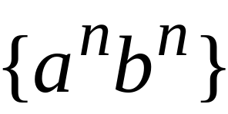
Context-Free Languages
Regular Languages

Slide 6
Context-Free Languages
Context-Free
Grammars
Pushdown
Automata
stack
automaton

Slide 7
Context-Free Grammars

Slide 8

Grammars
Grammars express languages
Example: the English language

Slide 9
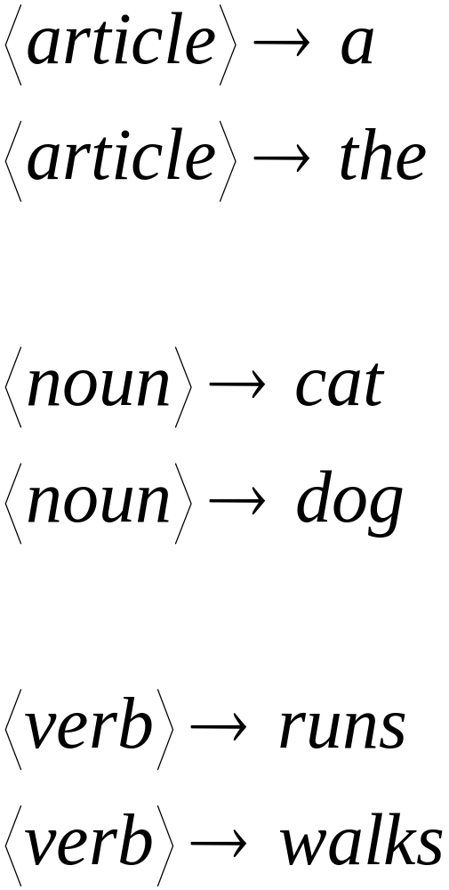

Slide 10
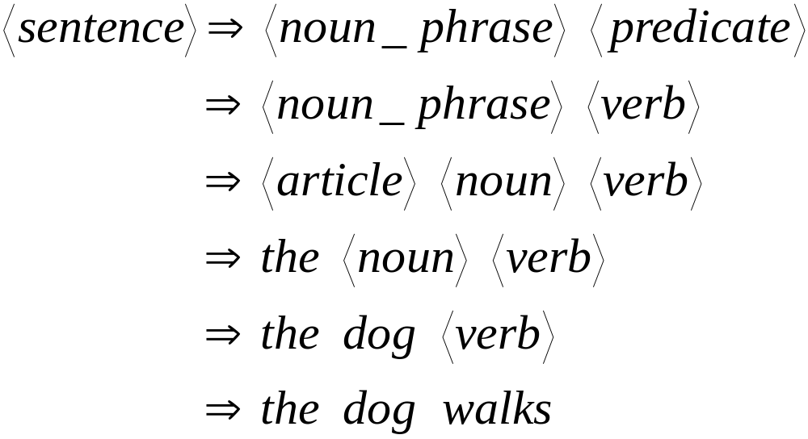
A derivation of “the dog walks”:

Slide 11
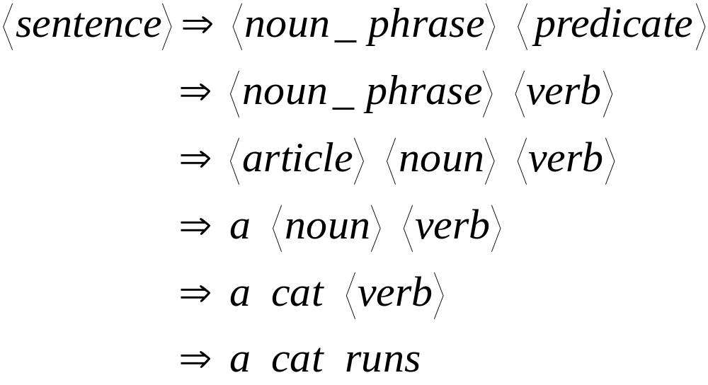
A derivation of “a cat runs”:

Slide 12
Language of the grammar:
L = { “a cat runs”,
“a cat walks”,
“the cat runs”,
“the cat walks”,
“a dog runs”,
“a dog walks”,
“the dog runs”,
“the dog walks” }

Slide 13
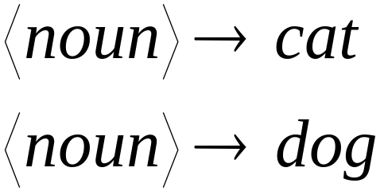
Notation
Production Rules
Variable
Terminal

Slide 14





Another Example
Grammar:
Derivation of sentence :

Slide 15



Grammar:
Derivation of sentence :

Slide 16

Other derivations:

Slide 17

Language of the grammar

Slide 18





More Notation
Grammar
Set of variables
Set of terminal symbols
Start variable
Set of Production rules

Slide 19




Example
Grammar :

Slide 20
More Notation
Sentential Form:
A sentence that contains
variables and terminals
Example:
Sentential Forms
sentence

Slide 21

We write:
Instead of:

Slide 22

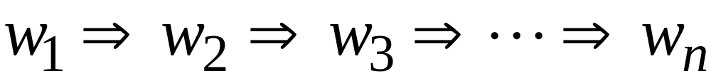
In general we write:
If:

Slide 23
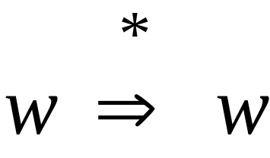
By default:

Slide 24
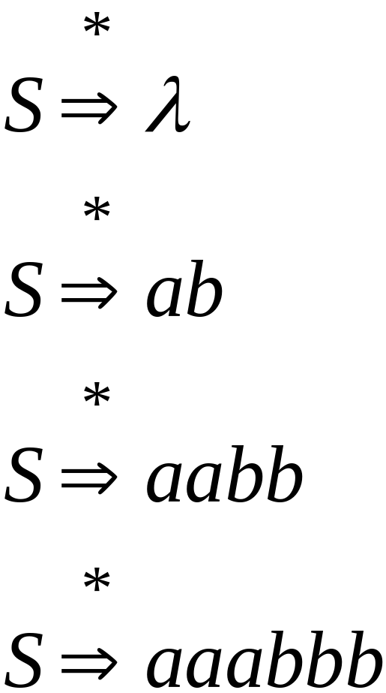
Example
Grammar
Derivations

Slide 25
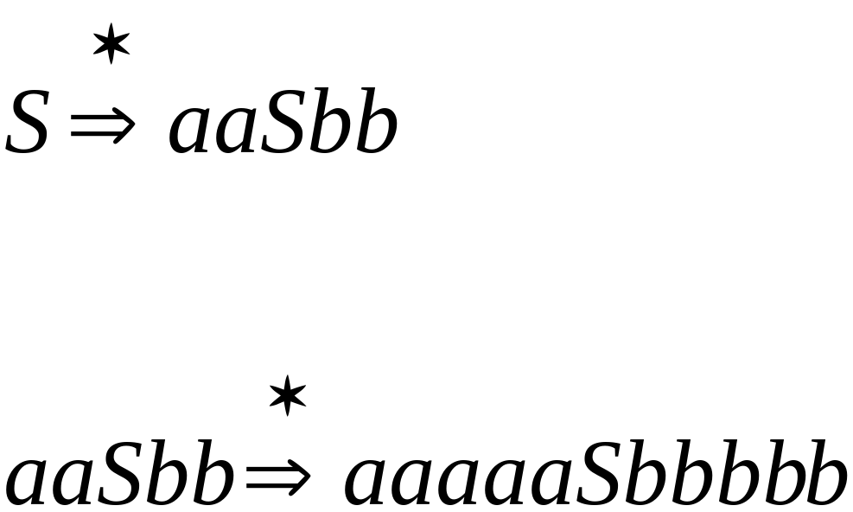
Example
Grammar
Derivations

Slide 26
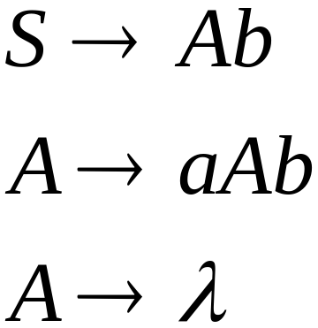
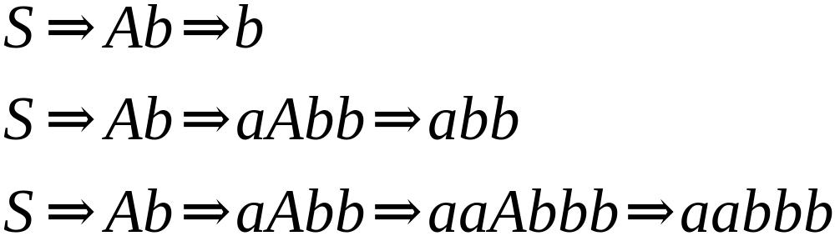
Another Grammar Example
Grammar :
Derivations:

Slide 27
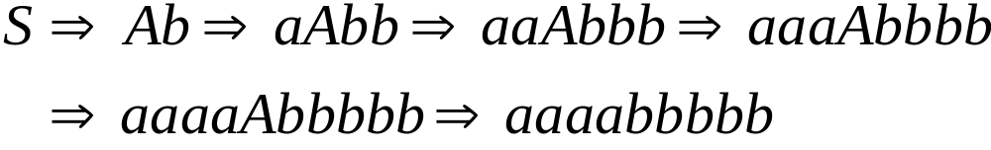
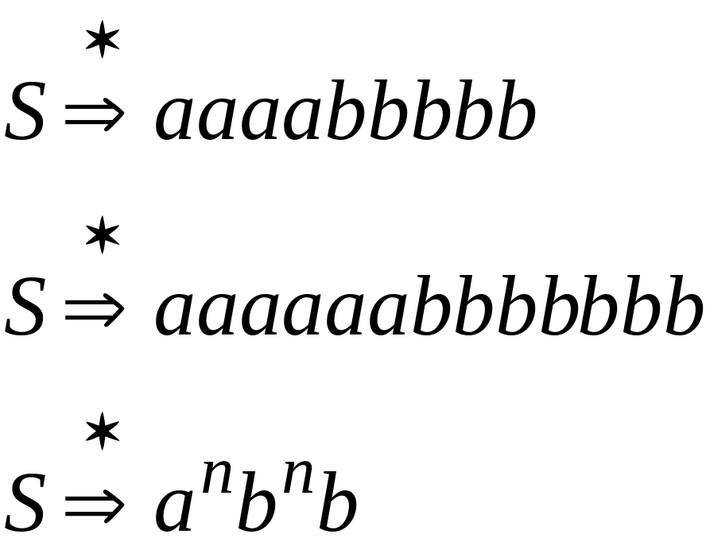
More Derivations

Slide 28

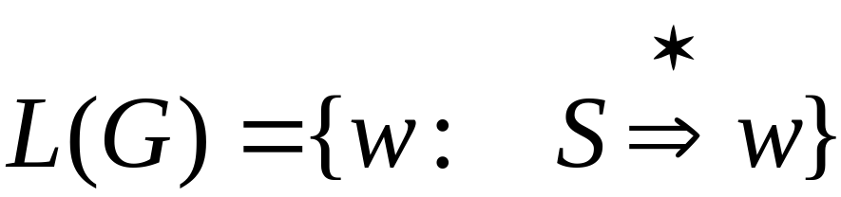
Language of a Grammar
For a grammar
with start variable :
String of terminals

Slide 29

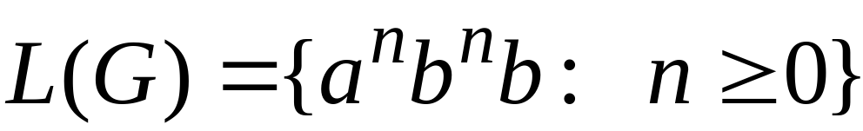
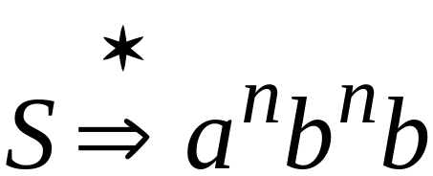
Example
For grammar :
Since:

Slide 30
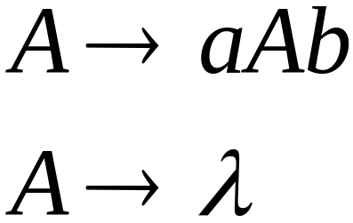
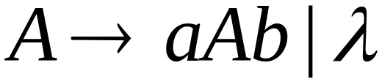
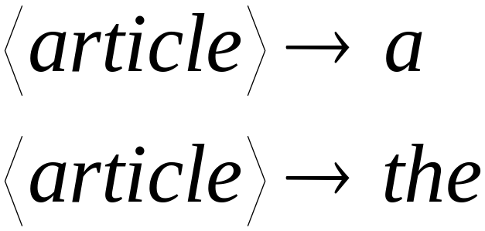
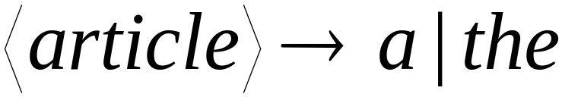
A Convenient Notation

Slide 31
Example
A context-free grammar :
A derivation:

Slide 32
A context-free grammar :
Another derivation:

Slide 33


Describes parentheses:
(((( ))))

Slide 34
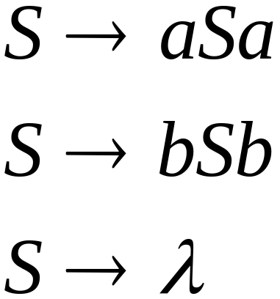
Example
A context-free grammar :
A derivation:

Slide 35
A context-free grammar :
Another derivation:

Slide 36


Slide 37
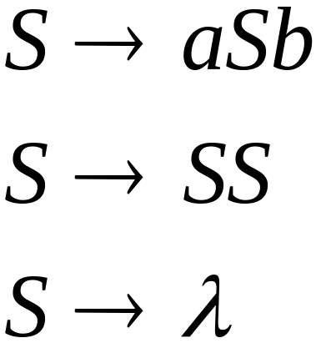
Example
A context-free grammar :
A derivation:

Slide 38
A context-free grammar :
A derivation:

Slide 39
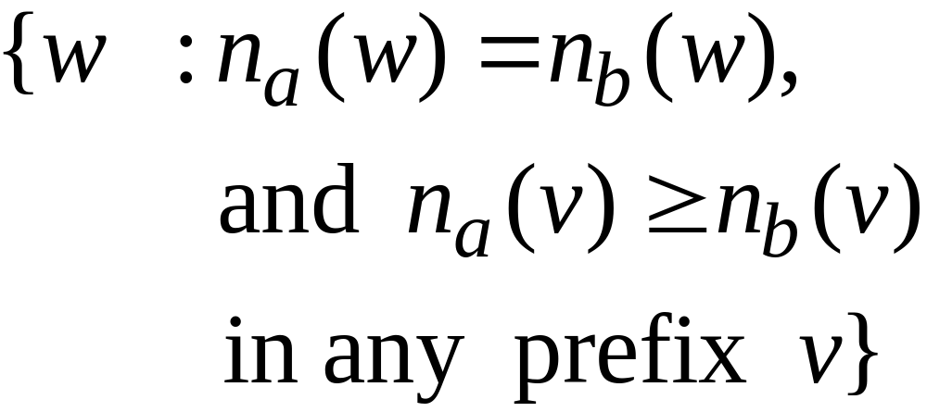
Describes
matched
parentheses:
() ((( ))) (( ))

Slide 40


Definition: Context-Free Grammars
Grammar
Variables
Terminal
symbols
Start
variable
Productions of the form:
Variable
String of variables
and terminals

Slide 41


Slide 42

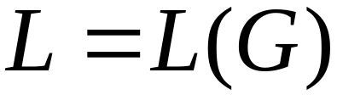
Definition: Context-Free Languages
A language is context-free
if and only if
there is a context-free grammar
with

Slide 43
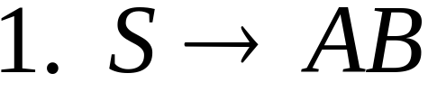
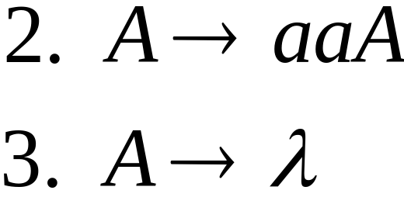
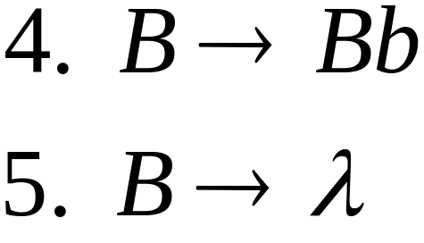


Derivation Order
Leftmost derivation:
Rightmost derivation:

Slide 44
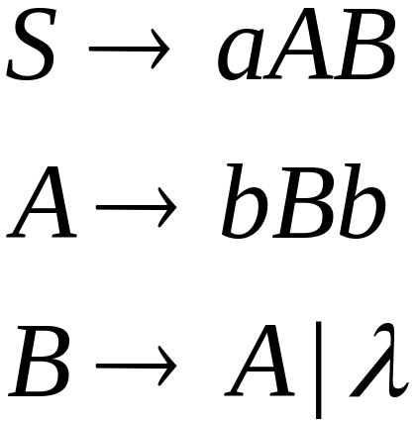
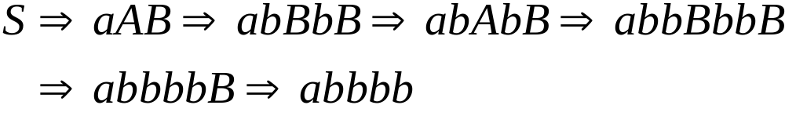
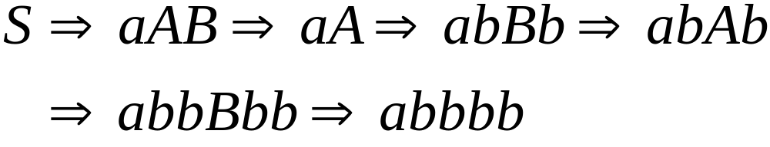
Leftmost derivation:
Rightmost derivation:

Slide 45
Derivation Trees

Slide 46

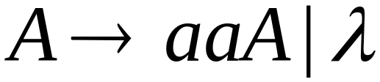
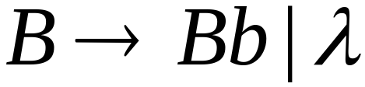





Slide 47



Slide 48


Slide 49


Slide 50
Derivation Tree

Slide 51
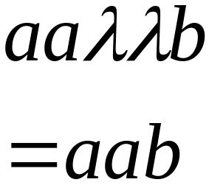
Derivation Tree
yield

Slide 52
Ambiguity

Slide 53





leftmost derivation

Slide 54

leftmost derivation

Slide 55
Two derivation trees

Slide 56
The grammar
is ambiguous:
string
has two derivation trees

Slide 57
The grammar
is ambiguous:
string
has two leftmost derivations

Slide 58

Definition:
A context-free grammar is ambiguous
if some string has:
two or more derivation trees

Slide 59
In other words:
A context-free grammar is ambiguous
if some string has:
two or more leftmost derivations
(or rightmost)

Slide 60

Why do we care about ambiguity?
take

Slide 61



Slide 62






Slide 63
Correct result:

Slide 64
Ambiguity is bad for programming languages
We want to remove ambiguity

Slide 65

Another Ambiguous Grammar
IF_STMT
if EXPR then STMT
if EXPR then STMT else STMT

Slide 66
If expr1 then if expr2 then stmt1 else stmt2
IF_STMT
if
expr1
then
STMT
if
expr2
then
stmt1
else
stmt2
IF_STMT
if
expr1
then
STMT
else
stmt2
if
expr2
then
stmt1

Slide 67
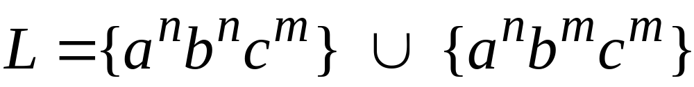

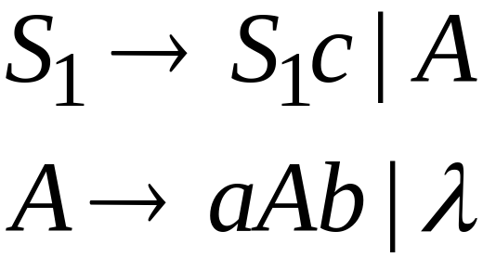
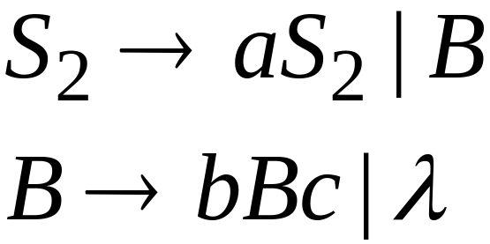
Inherent Ambiguity
Some context free languages
have only ambiguous grammars
Example:

Slide 68
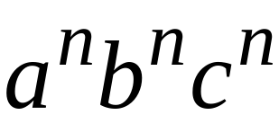



The string
has two derivation trees

